Slide 1
Pathfinding for Evolving Terrain
CSCI 4101 Midterm-presentation
Group 4 10/04/2023
Lenaoria Guerin
Eddie Andres Castro
Shijun Jiang
Notes:
Eddie

Slide 2

Problem Statement
Finding the most efficient / shortest path to reach a player as the amount of obstacles change/ increase
Useful to solve to create more intelligent enemy AI in a game environment that changes
Notes:
Eddie

Slide 3

The Algorithm we chose and why
For our solution we are using the A* algorithm
Used in Unity Game Engine for Pathfinding
Combines Breadth First Search and Dijkstra’s Algorithm
Breadth First Search
estimates the distance to the goal point
Dijkstra’s Algorithm
the distance from the start point
Notes:
Eddie

Slide 4
Breadth First Search
Breadth First Search is an algorithm that explores equally in all directions.
In the context of a grid, a key idea/implementation of Breadth First Search is a frontier, that uses a process called “flood fill”.
In another implementation of Breadth First Search, the exploration of paths will stop as soon as the goal is found.
Notes:
Eddie

Slide 5
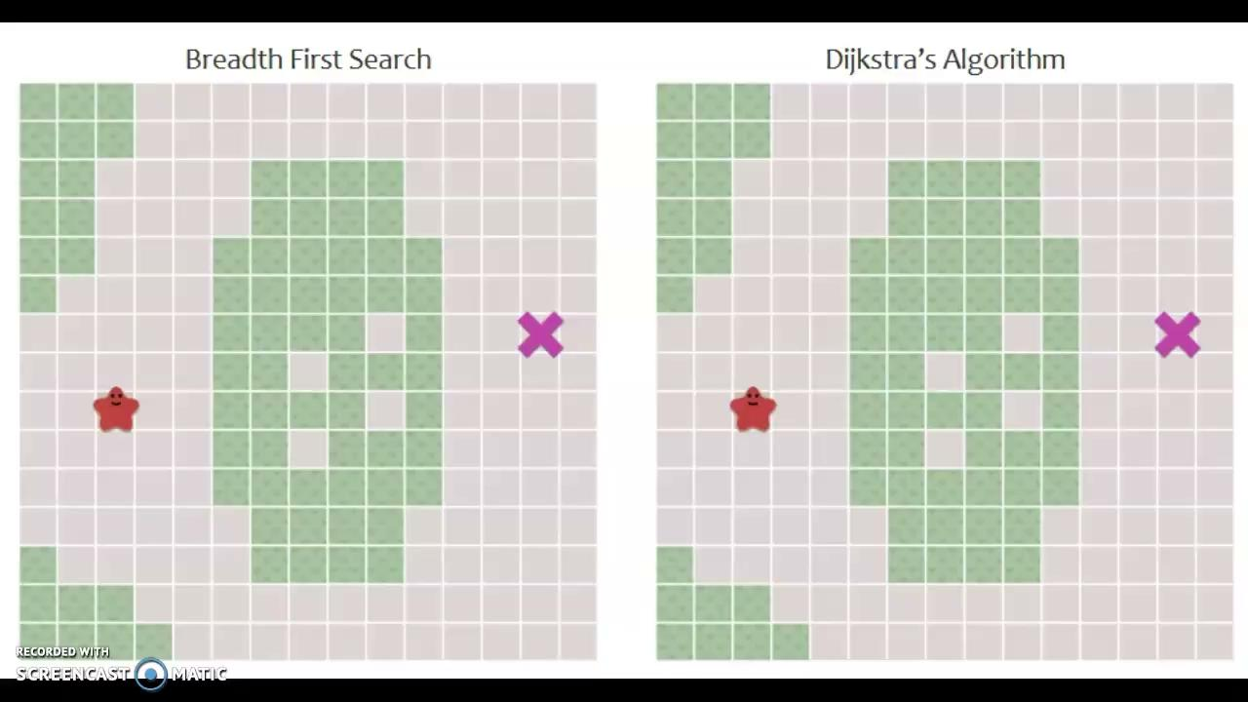
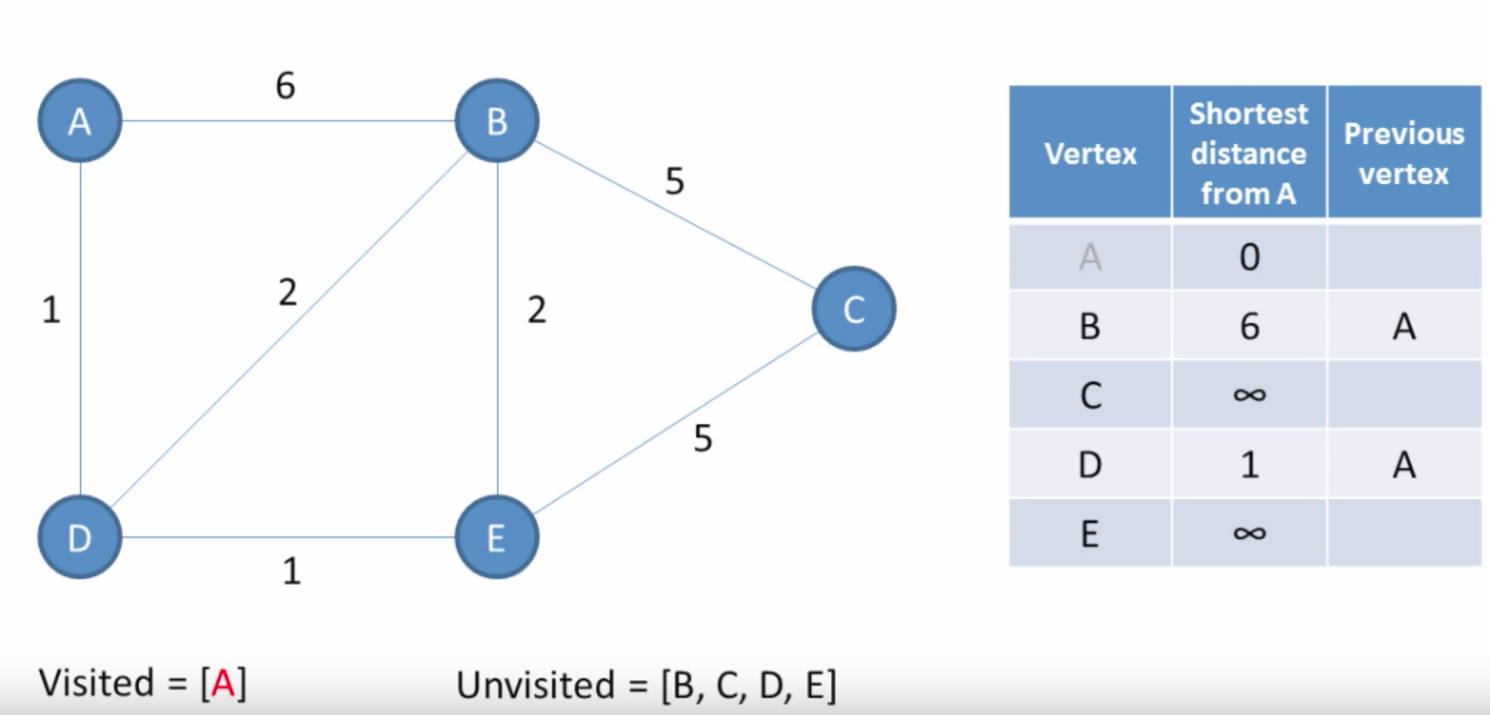
Dijkstra Algorithm
Visits vertices in the graph starting with the object’s starting point.
Repeatedly examines the closest not-yet-examined vertex
Favors lower cost paths and works on graphs where all weights are positive.
3
D
2
D
D
Notes:
Lenaoria
Dijkstra’s Algorithm works by visiting vertices in the graph starting with the object’s starting point. It then repeatedly examines the closest not-yet-examined vertex, adding its vertices to the set of vertices to be examined. It expands outwards from the starting point until it reaches the goal. Dijkstra’s Algorithm is guaranteed to find a shortest path from the starting point to the goal, as long as none of the edges have a negative cost.

Slide 6
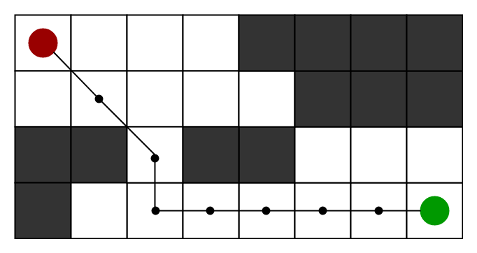
A* Algorithm
A* is an algorithm for finding the shortest path from a start point to an end point in a graph or grid.
It uses heuristics to help prioritize directions that are most likely to be the shortest paths
h(n)
f(n)
g(n)
Notes:
Shijun
In the game, the character we control needs to move from one point to another. How to ensure that the route our character chooses is the shortest and safest? The answer is to use the A* algorithm. Unlike other traditional pathfinding algorithms, Algorithm A is unique in that it uses heuristics to help determine the direction that is most likely to be the shortest path. In short, it not only takes into account the distance from the starting point to the current point, but also the estimated distance from the current point to the end point. This estimate allows the A* algorithm to find the shortest path quickly and accurately.

Slide 7
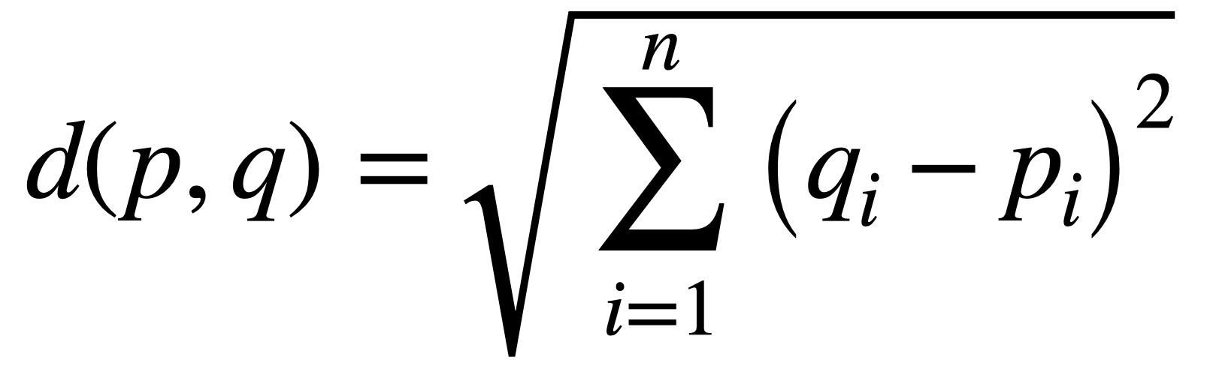
A* algorithm
We can use Euclidean distance to estimate the distance from the current location to the end point.
g(n)
Actual distance from starting point to current point
h(n)
Its value is equal to h(n)+g(n), which represents the estimated shortest distance from the starting point through the current point to the end point.
f(n)
The core of the algorithm of the entire game is to start from the starting point, consider all surrounding nodes, and select the node with the smallest f(n). This process is repeated until the end point is reached or all possible nodes are considered. Implementing the A* algorithm can provide enemies with a clear path guide to the player.
Notes:
Shijun
h(n): Although in actual game terrain, our character may not always walk in a straight line, this provides us with an effective heuristic estimate.
g(n):This is information we already know because the characters have already been on this journey.
f(n) gives us an estimate of the shortest path from the starting point to the end point through the current point.

Slide 8



Tools
Python
Used in AI and Games industry
We all agreed on it
Version control so we can all contribute to the project
Github
Pygame
To visually represent the Algorithm
Notes:
Shijun
Github:In a large project where many people collaborate, version control is crucial. Without effective version control, we may run the risk of code conflicts, lost updates, or even corrupted project files. To solve this problem, we chose Github as our version control tool, ensuring that each team member can contribute to the project without interfering with each other.
Python is our first choice. Not only because of Python's wide application in the AI and game industries, but also rich libraries that make development easier and more efficient. Every member of our team reached a consensus on this and chose Python as the development language.
Lastly, we need a powerful graphics library to provide a visual representation of our algorithms. That's why we chose Pygame. Pygame is a cross-platform game graphics library written in Python. With Pygame, we can quickly prototype our algorithm and turn it into a real, interactive game.

Slide 9
Challenges
Constraints
Issues
Using Pygame
Map size
Ensuring the obstacles do not create a scenario where the path to the player is no longer possible
2D Space
No need to worry about a 3rd Axis Z
Closed Map - cannot wrap around X and Y axises
Some obstacles that are places might have no effect on the algorithm finding the shortest path
We should be considerate about how obstacles are added onto the map
Notes:
Shijun
Our game scene is a 2D space, which means we only care about the X and Y axes and don't have to worry about the third axis Z that adds complexity. This greatly simplifies our pathfinding problem. Furthermore, our map is closed, which means that players cannot travel from one end of the map to the other. This provides clear boundaries for our pathfinding algorithm. Certain obstacles may have no effect on the shortest path found by Dijkstra's algorithm. This is because if obstacles do not directly block the player's shortest path to their destination, Dijkstra's algorithm will simply ignore them.?

Slide 10
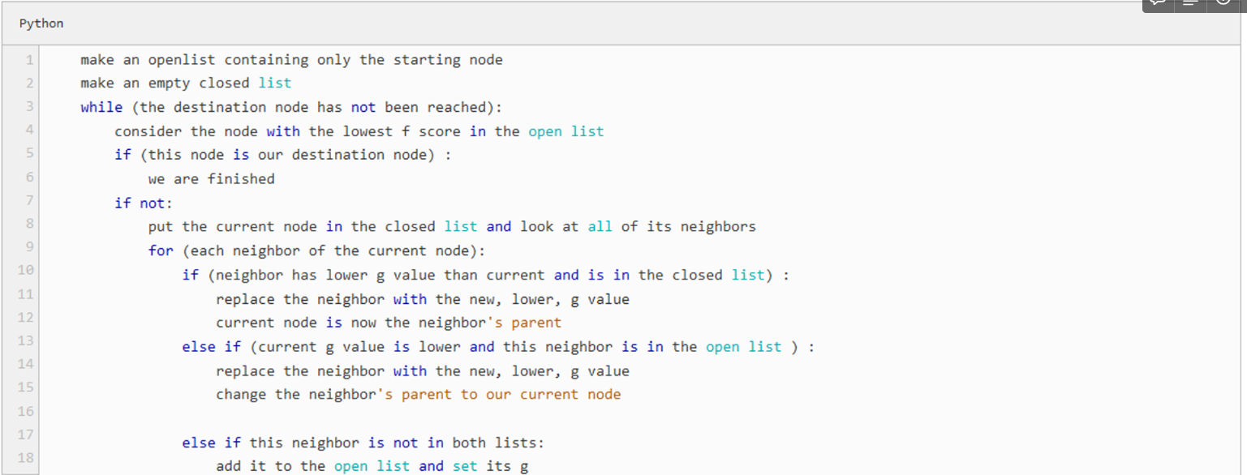
Pseudocode
Notes:
Lenaoria

Slide 11
Roadmap
Creating the Map
Instantiating obstacles onto the map
Player behavior
Implement A* Algorithm for the Enemy to get to the player(goal)
Implement timer to calculate and print time taken to find the shortest path and the number of obstacles
Run and record 3 trials of the amount of time the algorithm takes for each amount of Obstacles
Graph and Analyze results and Runtime
Notes:
Lenaoria

Slide 12


Division of Labor
Shijun Jiang
Eddie Andres Castro
Lenaoria
Guerin
Map creation
Adding obstacles to the map
Player Behavior
Enemy Pathfinding
Timer for shortest path and Obstacles
Run and Record Time
Research on the A* algorithm & Graph and Analyze results and Runtime
Notes:
Lenaoria

